Slide 1
Coordinate reference systems
Geomathematics, programming and geoinformatics
2026.02.25.
Ákos Bede-Fazekas

Slide 2
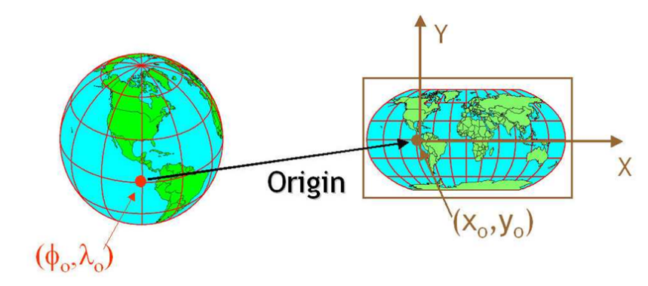
Coordinates and coordinate reference system
spatial data have
  coordinates and
  (optionally) coordinate reference system
these have 2 (or more) coordinate values:
  point
  breakpoint of lines (vertex)
  corner point of polygons
  raster cell (not stored, can be calculated)
coordinate reference system
  in which the coordinates are interpretable

Slide 3

Coordinates and coordinate reference system
different types of coordinate reference systems
different terms with somewhat different meaning
  coordinate reference system (CRS)
  spatial reference system (SRS)
  projection, projected reference system
I may casually refer to it as a projection, even though
it's not really that (e.g., WGS-84)
  apologies in advance

Slide 4
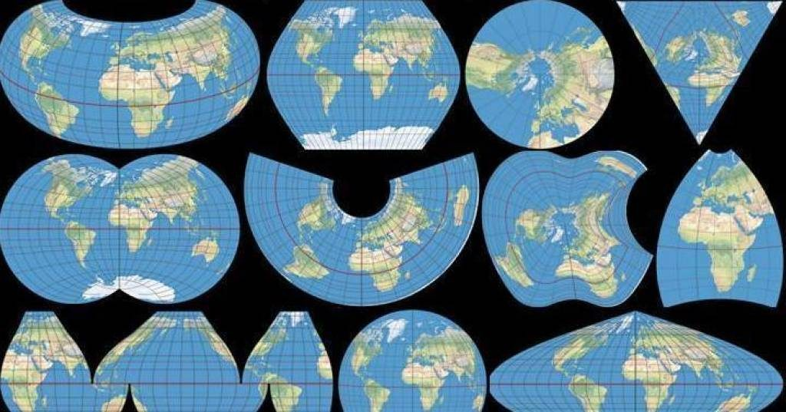
Most important coordinate reference systems
numerous coordinate reference systems
  choice depends on the task, scale, and area of investigation
global/regional/local (national projections)
instead of/in addition to the name, it is worth knowing their EPSG number
  unique identifier with 4 or 5 digits
  EPSG: European Petroleum Survey Group
  spatialreference.org/ref/epsg/

Slide 5
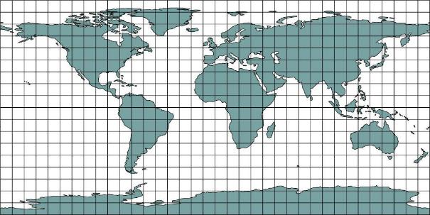
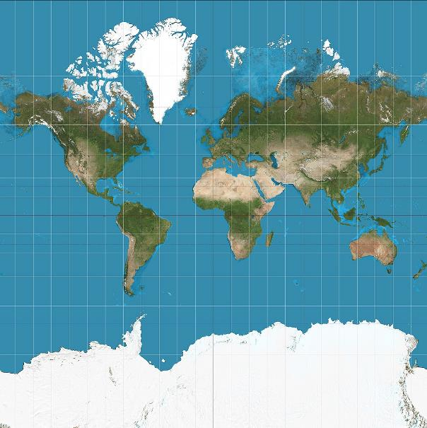
Most important coordinate reference systems
WGS-84
  World Geodetic System
  EPSG: 4326
  global, most well-known
  GPS devices use this → .gpx always in WGS-84
  .kml/.kmz always in WGS-84, too
  longitude (E) and latitude (N)
Pseudo-Mercator / Web Mercator
  EPSG: 3857
  global
  unit: meter

Slide 6
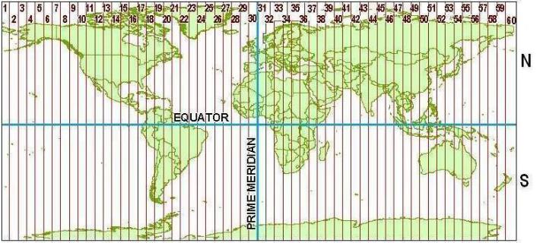
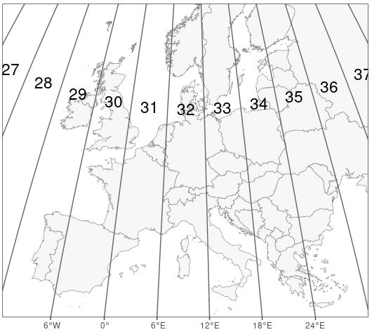
Most important coordinate reference systems
UTM
  Universal Transverse Mercator
  family of projections
  can be used separately in different regions, but the family covers the entire Earth
  northern vs. southern hemisphere, 6° division in east-west direction
  in Hungary: 33N (EPSG: 32633) and 34N (EPSG: 32634)

Slide 7
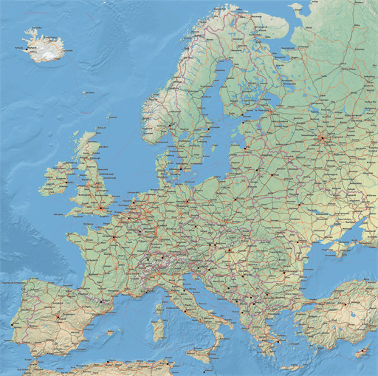
Most important coordinate reference systems
LAEA Europe
  Lambert Azimuthal Equal Area
  EPSG: 3035
  often used in Europe
  unit: meter

Slide 8
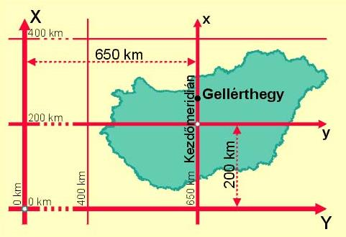
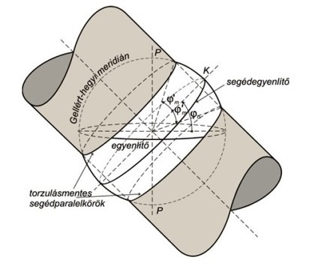
Most important coordinate reference systems
EOV
  Egységes Országos Vetület (EOV), Hungarian Datum 1972 (HD72)
  EPSG: 23700
  oblique conformal secant cylindrical projection
  Y coordinate: east-west, X coordinate: north-south
  always pay attention to the names of the axes if created from a non-spatial dataset based on coordinate columns
  Y coordinate is always >400,000, X coordinate <400,000 (in Hungary)
  unit: meter

Slide 9
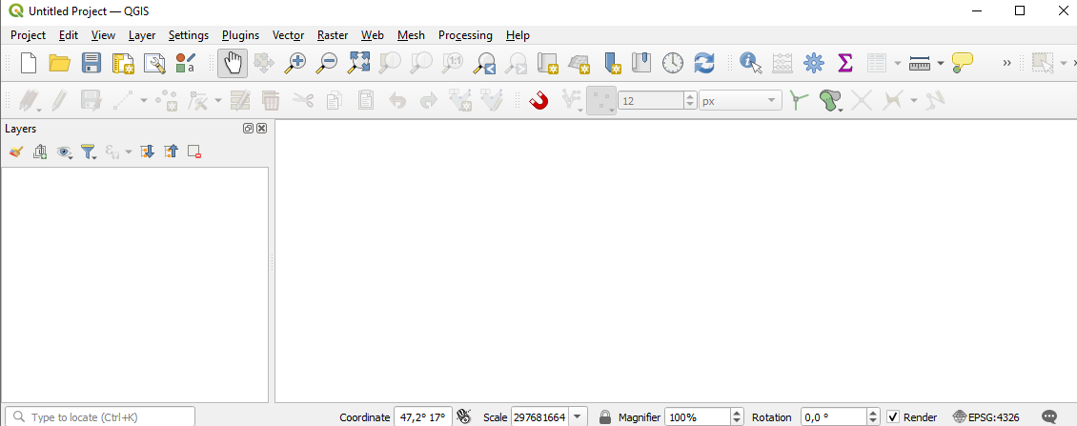
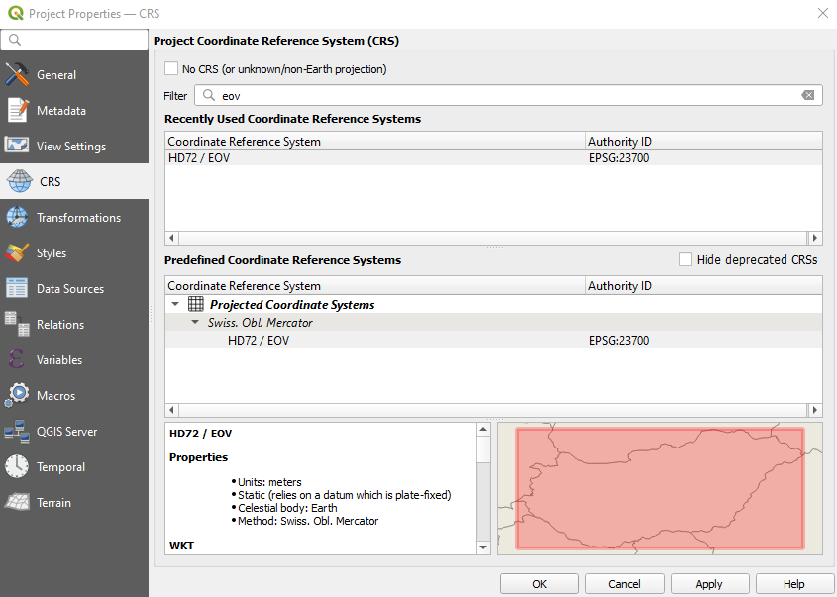
Coordinate reference systems in QGIS
coordinate reference system of the project
  display the mouse pointer coordinates accordingly in the status bar
change
  Project > Properties… > CRS
  or bottom right corner
  can be missing/unknown
  search for name or EPSG number
layers' CRS might differ from it
  for display, automatically ("on the fly") reprojects everything quickly and inaccurately into the project's CRS
Notes:
Projekt > Tulajdonságok… > Koordináta-rendszer

Slide 10
Coordinate reference systems in QGIS
coordinate reference system of the project
  display the mouse pointer coordinates accordingly in the status bar
change
  Project > Properties… > CRS
  or bottom right corner
  can be missing/unknown
  search for name or EPSG number
layers' CRS might differ from it
  for display, automatically ("on the fly") reprojects everything quickly and inaccurately into the project's CRS
Notes:
Projekt > Tulajdonságok… > Koordináta-rendszer

Slide 11
Coordinate reference systems in QGIS
coordinate reference system of the project
  display the mouse pointer coordinates accordingly in the status bar
change
  Project > Properties… > CRS
  or bottom right corner
  can be missing/unknown
  search for name or EPSG number
layers' CRS might differ from it
  for display, automatically ("on the fly") reprojects everything quickly and inaccurately into the project's CRS
Notes:
Projekt > Tulajdonságok… > Koordináta-rendszer

Slide 12
Coordinate reference systems in QGIS
coordinate reference system of the project
  display the mouse pointer coordinates accordingly in the status bar
change
  Project > Properties… > CRS
  or bottom right corner
  can be missing/unknown
  search for name or EPSG number
layers' CRS might differ from it
  for display, automatically ("on the fly") reprojects everything quickly and inaccurately into the project's CRS
Notes:
Projekt > Tulajdonságok… > Koordináta-rendszer

Slide 13
Coordinate reference systems in QGIS
coordinate reference system of the project
  display the mouse pointer coordinates accordingly in the status bar
change
  Project > Properties… > CRS
  or bottom right corner
  can be missing/unknown
  search for name or EPSG number
layers' CRS might differ from it
  for display, automatically ("on the fly") reprojects everything quickly and inaccurately into the project's CRS
Notes:
Projekt > Tulajdonságok… > Koordináta-rendszer

Slide 14
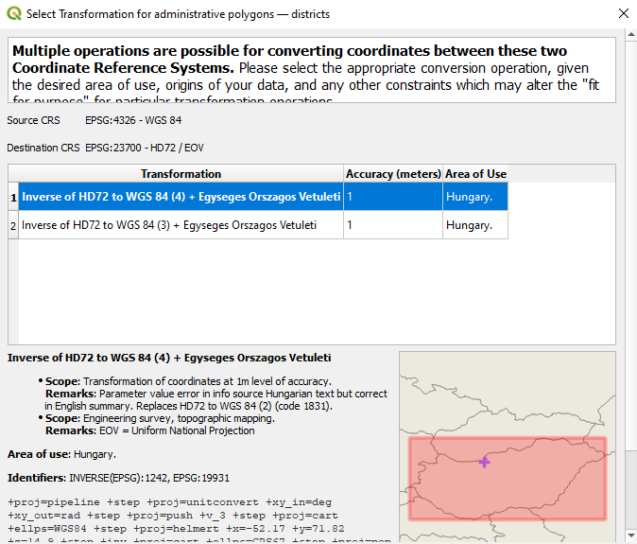
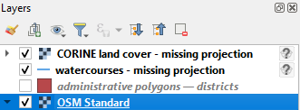
Coordinate reference systems in QGIS
if the project's and layer's CRS differs
  then it offers several transformation functions for "on the fly" reprojection
  any of them can be chosen
if the layer's CRS is missing
  indicated with a question mark at the layer manager

Slide 15
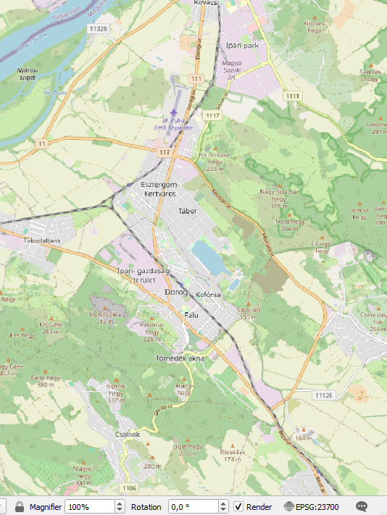
Coordinate reference systems in QGIS
DEMO
  create a new project
  what is its coordinate reference system?
  add OpenStreetMap basemap
  note: this is our first layer → project's CRS changes to Pseudo-Mercator
  zoom to Dorog (NW of Budapest)
  change the project's CRS to HD72 / EOV (EPSG: 23700)
  note: the basemap is slightly distorted

Slide 16
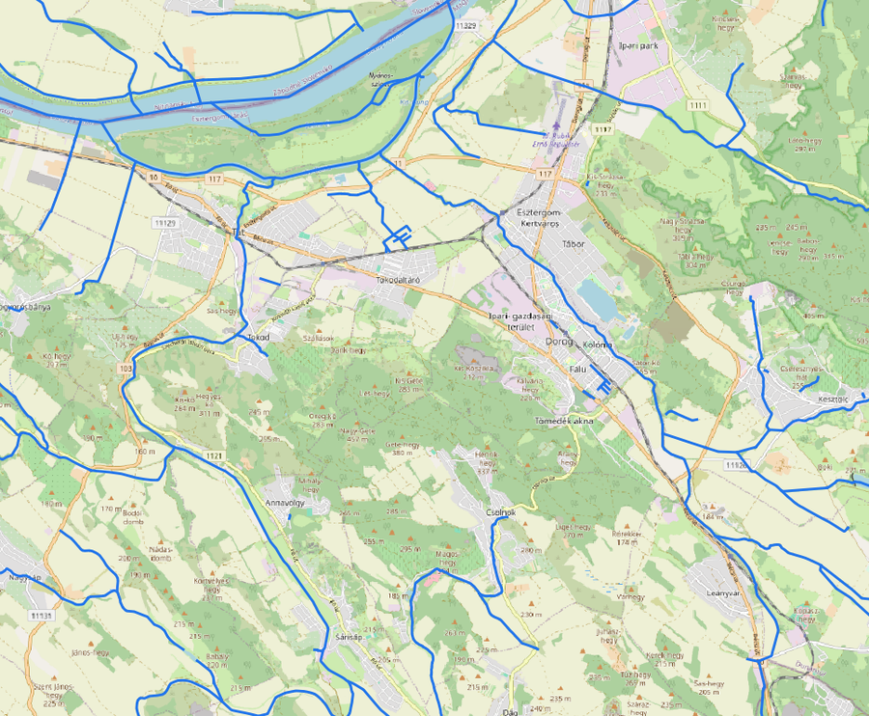
Coordinate reference systems in QGIS
DEMO
  add "districts" layer of administrative polygons.gpkg (it is in WGS-84)
  choose one of the transformation functions
  hide it
  add the "watercourses - missing projection.shp" file (unknown CRS)
  why is it displayed in the right place?

Slide 17
Coordinate reference systems in QGIS
DEMO
  add "districts" layer of administrative polygons.gpkg "districts" (it is in WGS-84)
  choose one of the transformation functions
  hide it
  add the "watercourses - missing projection.shp" file (unknown CRS)
  why is it displayed in the right place?
answer: because the project's CRS is precisely the one in which the layer's coordinates are measured
– ACCIDENTAL –

Slide 18
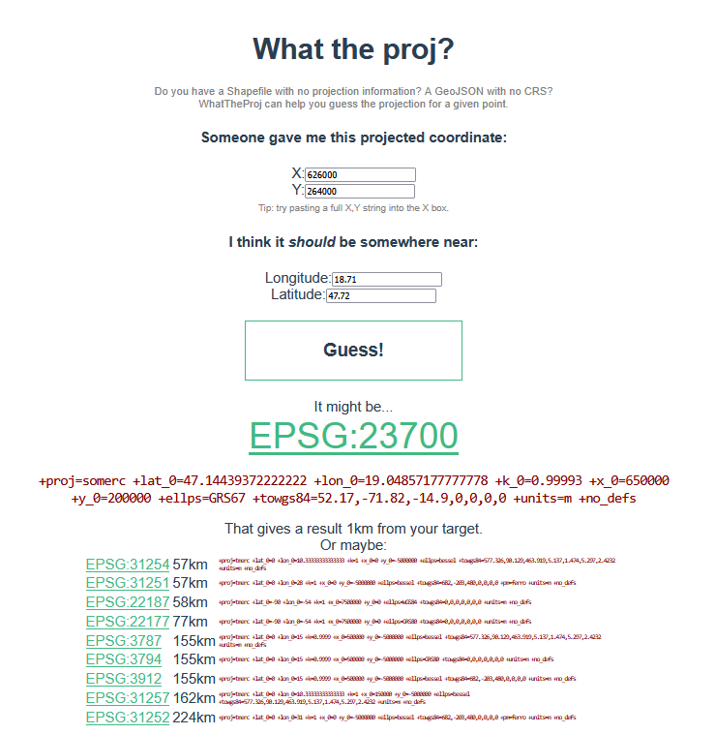
Tasks related to coordinate reference systems
two important tasks
  setting the CRS
  reprojection
setting the CRS
  do it only if the CRS is missing
  e.g., because the auxiliary file storing the CRS is missing
  or if it is wrongly set (coordinates are interpretable in a different CRS)
  in this case, we must infer the correct CRS based on the coordinate values
  this might help: stevage.github.io/WhatTheProj/

Slide 19
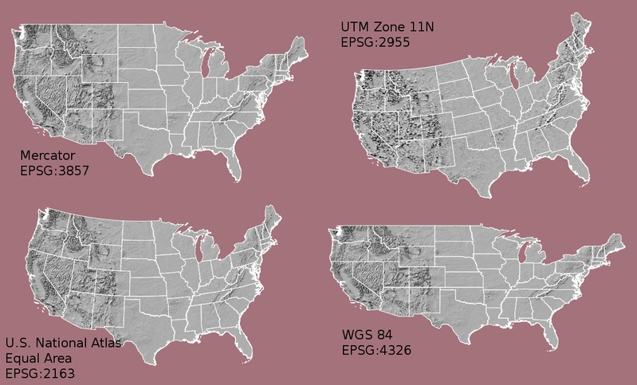
Tasks related to coordinate reference systems
reprojection
  this should be used in all other cases, i.e. when
  the CRS is known and is correct
  we just want to switch to another CRS
  and recalculate the coordinates

Slide 20
Tasks related to coordinate reference systems
DEMO
  add "CORINE land cover - missing projection.asc" to the project (unknown CRS)
  where is it?

Slide 21
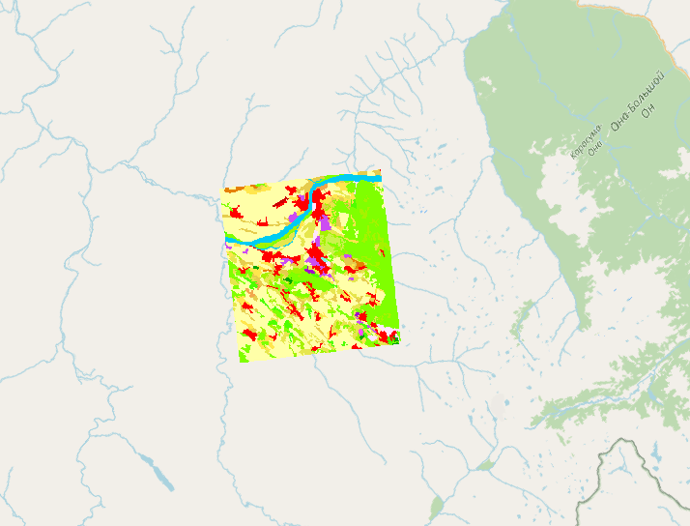
Tasks related to coordinate reference systems
DEMO
  add "CORINE land cover - missing projection.asc" to the project (unknown CRS)
  where is it?
  somewhere near the Russian-Mongolian border…
  however, it displays the region of Dorog (18,7°, 47,66°)
  let's guess it's CRS: stevage.github.io/WhatTheProj/

Slide 22
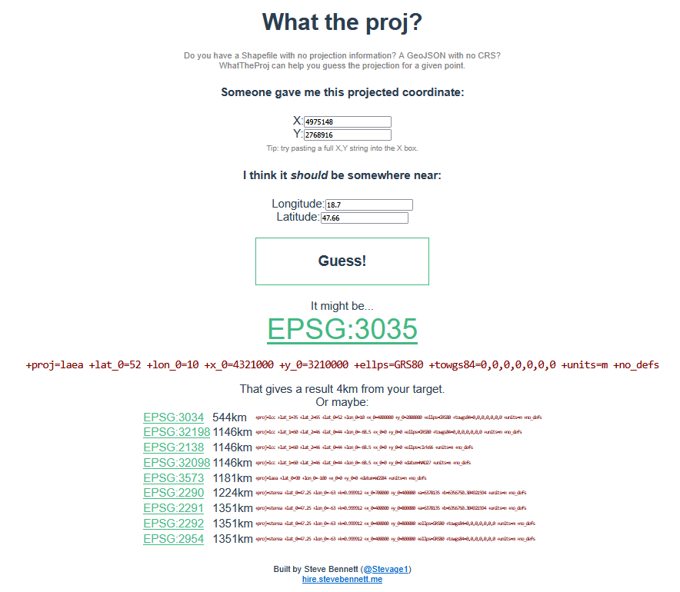
Tasks related to coordinate reference systems
solution: LAEA Europe (EPSG: 3035)
all that remains is to add the missing CRS

Slide 23
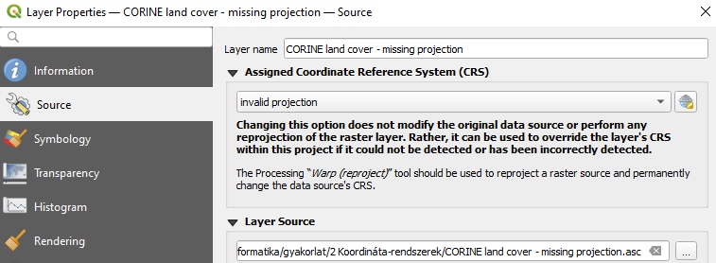
Setting the coordinate reference system
right-click > Properties… > Source > Assigned Coordinate Reference System (CRS)
  the file does not change
  but the project will
  but from this point on, the project will know that this is the CRS of the layer
  for both rasters and vectors
DEMO
  set the CRS of the land cover layer at the
  Properties → moved to the right place
  zoom to the layer
Notes:
jobb klikk > Tulajdonságok… > Forrás > Hozzárendelt koordináta referencia rendszer (CRS)

Slide 24
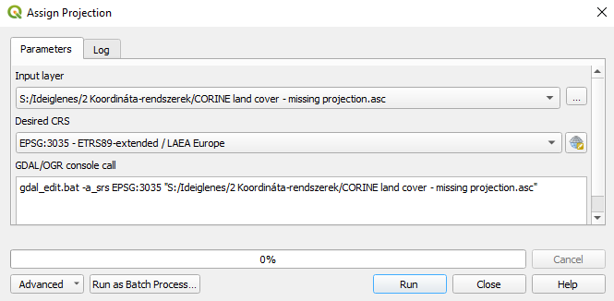
Setting the coordinate reference system
in the case of rasters, even this tool can be used to set the missing CRS:
  Processing toolbox > GDAL > Raster projections > Assign projection
Notes:
Feldolgozás eszköztár > GDAL > Raszter: vetületek > Vetület hozzárendelése

Slide 25
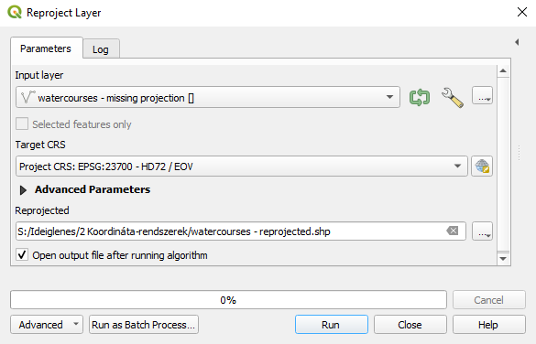
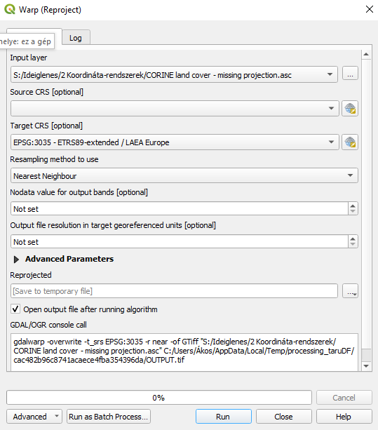
Setting the coordinate reference system
missing CRS can be set through "reprojection" as well
  creates a new file whose CRS will already be known
Processing toolbox > Vector general > Reproject layer
  in the case of vectors
Processing toolbox > GDAL > Raster projections > Warp (reproject)
  in the case of rasters
Notes:
Feldolgozás eszköztár > Vektor: általános > Réteg más vetületbe
Feldolgozás eszköztár > GDAL > Raszter: vetületek > Transzformálás hajlítással (vetületváltás)

Slide 26
Setting the coordinate reference system
missing CRS can be set through "reprojection" as well
  creates a new file whose CRS will already be known
Processing toolbox > Vector general > Reproject layer
  in the case of vectors
Processing toolbox > GDAL > Raster projections > Warp (reproject)
  in the case of rasters
DEMO
  we do not try them using inputs with missing CRS
  but see these examples ►
Notes:
Feldolgozás eszköztár > Vektor: általános > Réteg más vetületbe
Feldolgozás eszköztár > GDAL > Raszter: vetületek > Transzformálás hajlítással (vetületváltás)

Slide 27
Reprojection
works very differently for vectors and rasters
  therefore we should use two different tools
at first glance, vector transformation seems complicated
  since all vertex coordinates must be calculated
  in the case of rasters, it is sufficient to calculate the coordinates of the four corners

Slide 28
Reprojection
works very differently for vectors and rasters
  therefore we should use two different tools
at first glance, vector transformation seems complicated
  since all vertex coordinates must be calculated
  in the case of rasters, it is sufficient to calculate the coordinates of the four corners
that's true, however…
– COMING SOON –

Slide 29
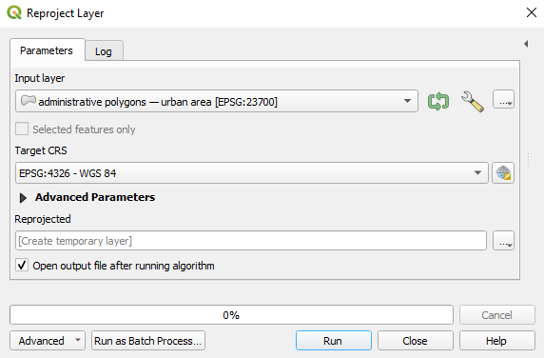

Reprojection – vectors
reprojection in the case of vectors
  Processing toolbox > Vector general > Reproject layer
DEMO
  add "urban area" layer of administrative polygons.gpkg
  reproject it (from EOV) to WGS-84, create a temporary layer
  note: temporary layer in the layer manager
temporary layers
  we don't have to fiddle with the path, name, extension
  but they are lost when QGIS is closed (or we must finalize them first)
Notes:
Feldolgozás eszköztár > Vektor: általános > Réteg más vetületbe

Slide 30
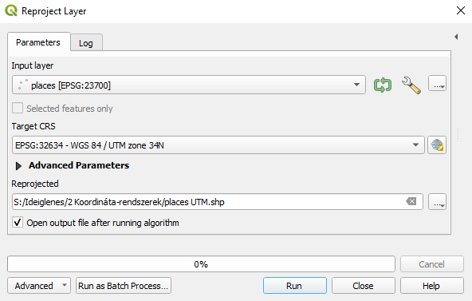
Reprojection – vectors
DEMO
  reproject places.shp to 34N UTM zone

Slide 31
Reprojection – rasters
  […] in the case of rasters, it is sufficient to calculate the coordinates of the four corners
that's true, however…

Slide 32
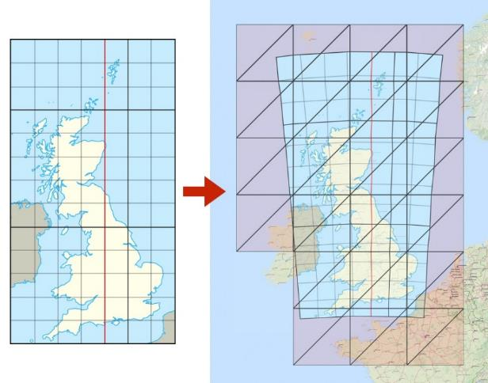
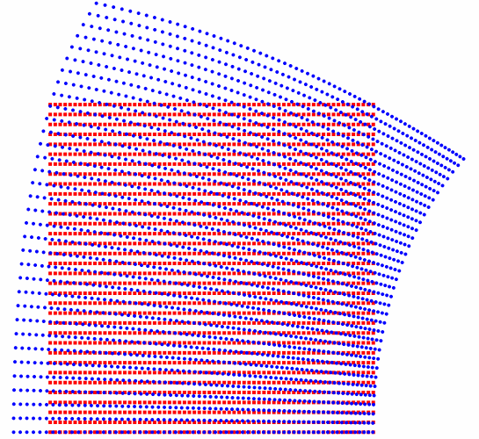
Reprojection – rasters
  […] in the case of rasters, it is sufficient to calculate the coordinates of the four corners
that's true, however…
  since the cells will be distributed differently in the new CRS (in order to achieve a regular square grid layout)
  so the cell centers will fall elsewhere
  meaning the cells will have to have new values

Slide 33
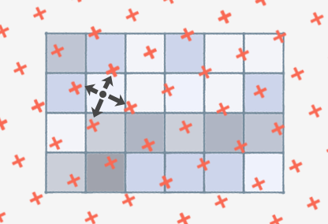
Reprojection – rasters
so we need to calculate the cell values for the new locations
  "resampling"
much slower than recalculation of the coordinates of vector vertices
  in the case of rasters, it is not the calculation of coordinates that takes a long time
  but that of the cell values
  vectors: no new value needs to be calculated
reprojection of rasters results in data loss!

Slide 34
Reprojection – rasters
so we need to calculate the cell values for the new locations
  "resampling"
much slower than recalculation of the coordinates of vector vertices
  in the case of rasters, it is not the calculation of coordinates that takes a long time
  but that of the cell values
  vectors: no new value needs to be calculated
reprojection of rasters results in data loss!
  if our project contains a raster and multiple vectors, we reproject the vectors to the CRS of the raster

Slide 35
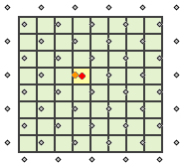
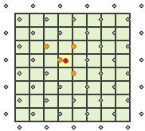
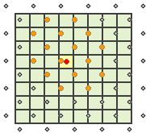
Resampling methods
4 important resampling methods
from which 2 are useful for categorical/logical cell values
  mode: most common value, majority
  nearest neighbor
and 2 for continuous cell values
  bilinear interpolation
  cubic convolution
for continuous cell values, also nearest neighbor method can be used
  this is the fastest (the least computationally intensive)
blurring of result
  nearest neighbor < bilinear interpolation < cubic convolution

Slide 36
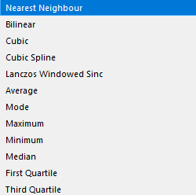
Resampling methods
and a lot more:

Slide 37
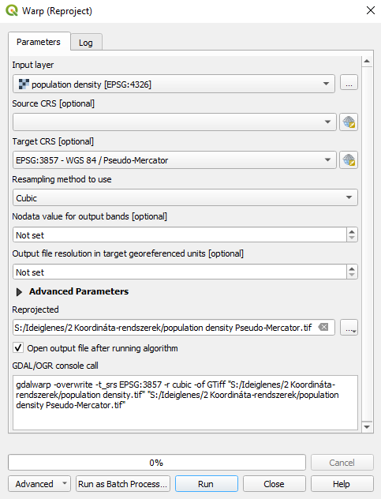
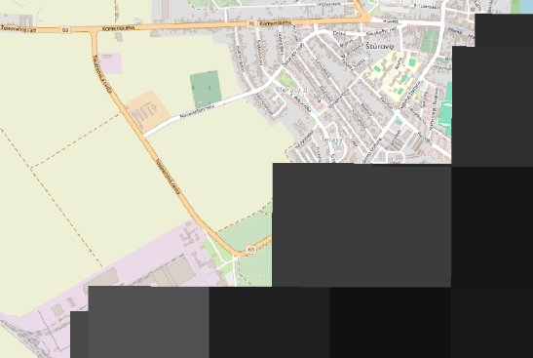
Reprojection – rasters
reprojection in the case of rasters
  with the tool mentioned earlier
  Processing toolbox > GDAL > Raster projections > Warp (reproject)
DEMO
  reproject population density.tif from WGS-84 to Pseudo-Mercator using cubic convolution resampling method
  let's observe the cells
Notes:
Feldolgozás eszköztár > GDAL > Raszter: vetületek > Transzformálás hajlítással (vetületváltás)

Slide 38
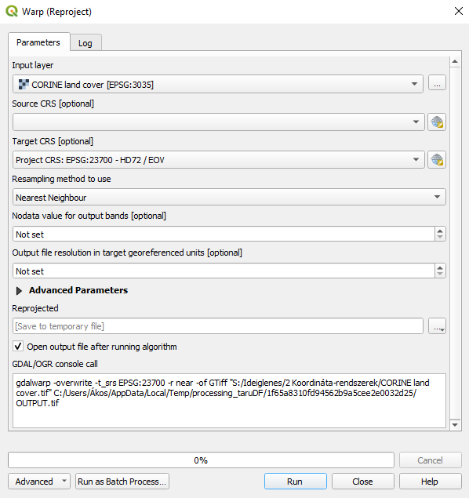
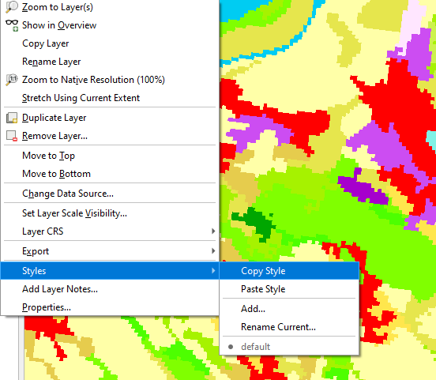
Reprojection – rasters
DEMO
  reproject CORINE land cover.tif
  using nearest neighbor resampling method
  to HD72/EOV projection
  creating a temporary layer
bonus task
  copy the coloring style of the previous layer to the new temporary layer

Slide 39
Practical exercises
add "municipal area" layer of administrative polygons.gpkg
reproject it to LAEA Europe projection, saved to ESRI shapefile format
delete it from the layer manager
  then delete the .prj auxiliary file belonging to the saved shapefile
add it to the project
  set the missing CRS at the Properties
set the project's CRS to WGS-84
add elevation.tif
reproject it to 34N UTM zone
  use bilinear interpolation
  the result should be a temporary layer

Slide 40
Thank you for your attention!
questions?

